Slide 1

Capstone Project Shopping during Covid-19 Lock Down in South Africa
Jacques Jansen van Rensburg
March 2020

Slide 2

Background
At the end of 2019, an outbreak of the Coronavirus (SARS-CoV-2) was identified in Wuhan, Hubei, China and was recognised as a pandemic by the World Health Organization (WHO) on 11 March.
A lot of people who contract the virus, does not show symptoms and therefore not even know they are sick. Even if they do not show symptoms, they are still contagious and are thus a problem for other p
It is because of this that many governments across the world have decided to put their whole countries in lock-down so as to stop the spread of the disease. During this lock down period, people are not allowed to leave their homes, except to buy essential goods, such as food, toiletries and cleaning supplies, and also to seek medical attention.eople who might show severe symptoms from the disease.

Slide 3
Problem
Because of the threatening nature of this virus, a lot of people might want to avoid people all together during this time. Since (in South Africa) even delivery services have been cancelled, many people might want to go to grocery stores which are further away from other people. Since the only place where there are allowed to be people are Pharmacies and hospitals, one might want to know where there are grocery stores away from such amenities.

Slide 4

Interest
People who want to go to a grocery store away from other people can benefit from this project, as they will see where the different types of amenities are around their home.
Other people, who might want to get all their shopping, medical attention and medication collection done in the shortest time possible can also use this project to see where all these amenities are close to one another.

Slide 5

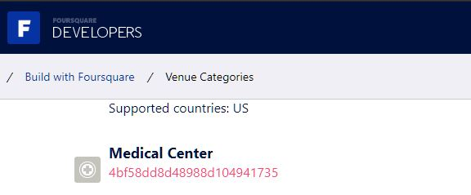
Data Acquisition
The data for this project comes primarily from Foursquare.com.
For the different data sets, I used the different category IDs from Foursquare (https://developer.foursquare.com/docs/build-with-foursquare/categories/ )

Slide 6
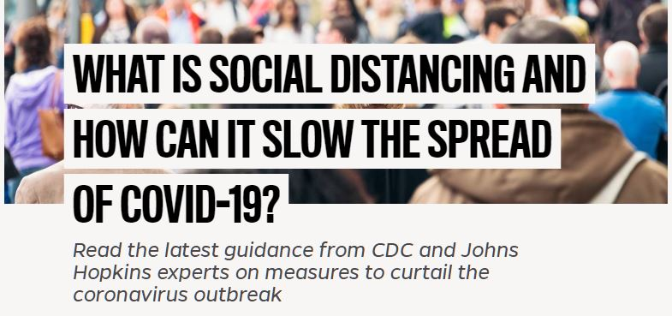
Data Acquisition cont.
As an ‘extra feature’ I also added a Word Cloud generate from an article called "What is Social Distancing and how can it slow the spread of Covid-19?" which I found on https://hub.jhu.edu/2020/03/13/what-is-social-distancing/

Slide 7

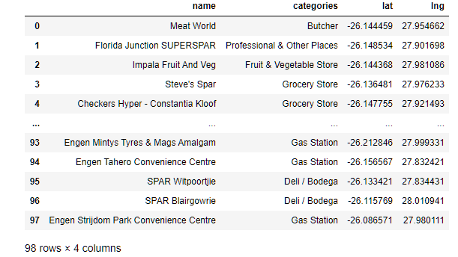
Data Cleaning
Once I got all the data that I wanted in the form of a json file from Foursquare, I assign column names (“name”, “categories”, “lat” (latitude) and “lng” (lomgditude). I did each dataset (Groceries, Pharmacies and Medical attention) separately to get three data frames

Slide 8
Methodology
Folium and Goepy Map Plotting
For each section (“Groceries”, “Pharmacies” and “Hospitals”) I used Folium to draw the maps and then Geopy to plot all the venues in each specific data frame according to the GPS coordinates that we received from Foursquare. First I made a map for each data frame separately, but each with different coloured plot dots.

Slide 9
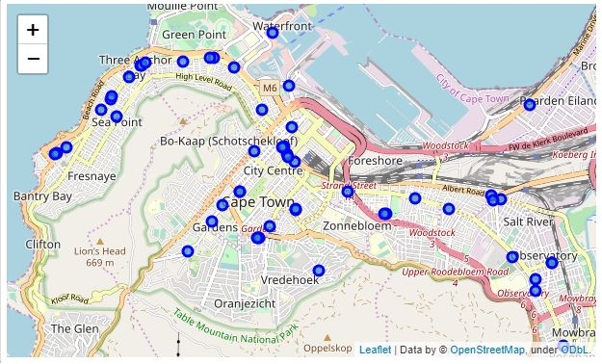
Map with grocery stores plotted in blue

Slide 10
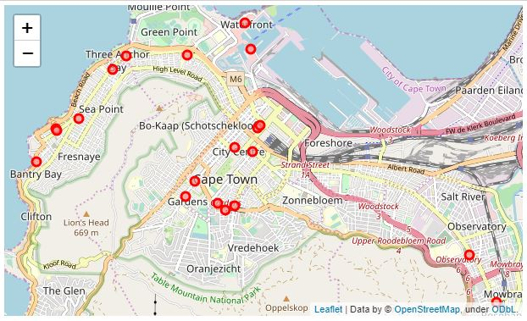
Map with pharmacies plotted in red

Slide 11
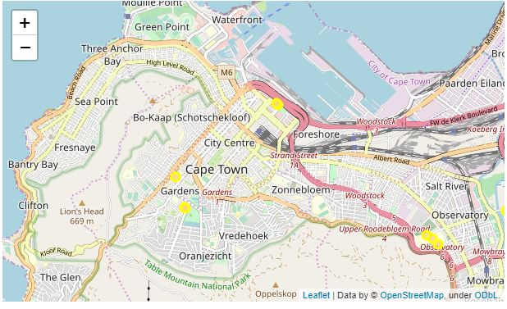
Map with Medical Centres plotted in yellow

Slide 12
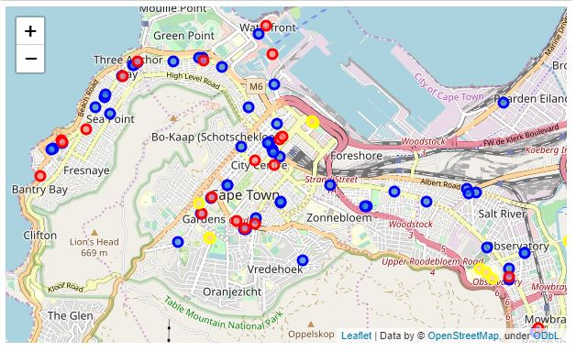
Zoomed out Picture of Grocery stores (blue), Pharmacies (Yellow) and Medical Centres (Red)
I then combined the data to plot all the locations with their different coloured plot dots (Grocery stores = blue, Pharmacies = red, and Hospitals = yellow) on One map.

Slide 13

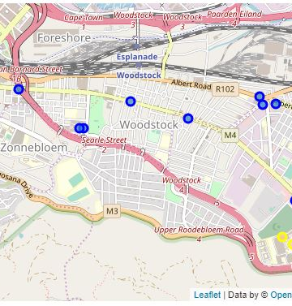
Results
This specific search (from 2 Darling Street, Cape Town, South Africa) showed that in the Woodstock area, there are only grocery stores and no pharmacies or medical centres.

Slide 14
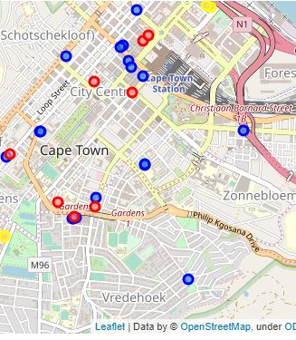
Results Cont.
Areas like Cape Town CBD, Claremont and Observatory have all amenities in one area

Slide 15

Discussion
From this specific search, it is clear, that when one goes for shopping in the Woodstock area, one will be well away from pharmacies and Medical centres. If a person is scared to be near medical centres and pharmacies for fear of running into someone who has the virus, this would be the place to do shopping.
However, if a person wants to see a medical professional, get medication and do grocery shopping in one run, Cape Town CBD, Claremont, or Observatory will be better suited.

Slide 16
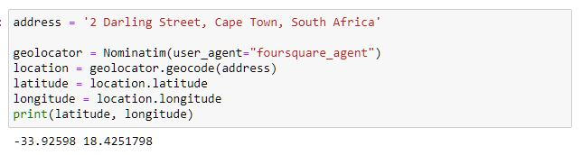
Conclusion
I do feel that this project could help people decide where to do their shopping or where to seek medical attention. Any location could be substituted in the ‘address’ where it would give an output with the latitude and longitude coordinates.

Slide 17
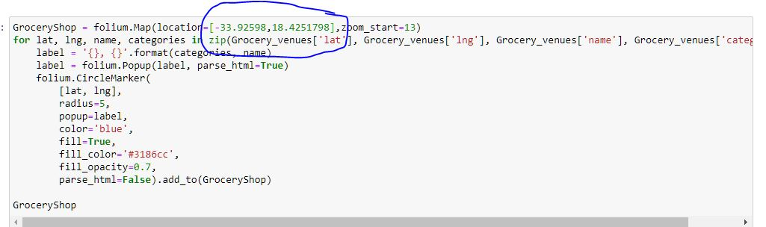
Conclusion Cont.
When one gets the coordinates, it must just be substituted in the url for foursquare and the location of the map.

Slide 18
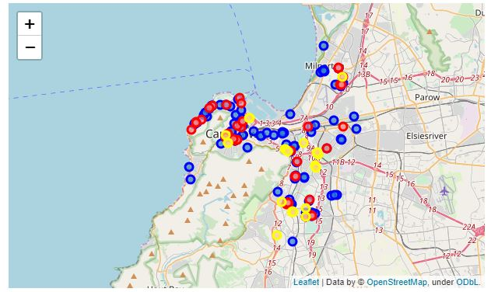
Conclusion Cont.
With the different colours of the plot points, it is clear to see which amenities are where, and which amenities are close to other amenities.

Slide 19
Word Cloud
As an extra feature I also added a word cloud to show what Social Distancing means during this time. I opened the txt file and set the figure size. After realising that the names "Singleby" and "Rivers" and also the word "says" comes up in the word cloud, I added it to my stopwords and re-generated the cloud

Slide 20
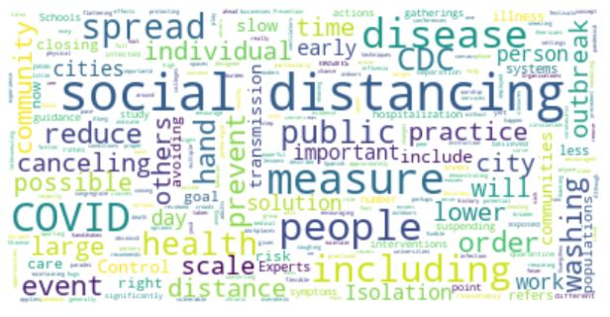

Slide 21
I would like to thank everyone who has taken the time to read my report, and with all that is going on in the world today with the Coronavirus is would like to take this opportunity to say: “Stay safe!”

